Slide 1
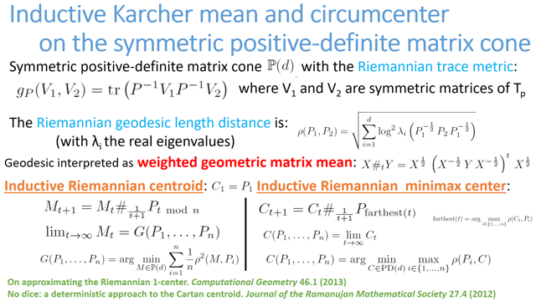

Slide 2

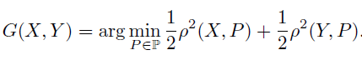
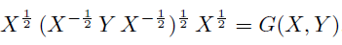
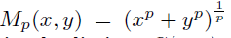
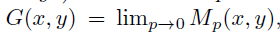
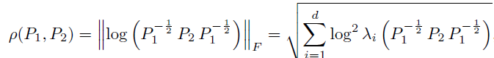
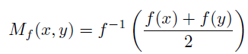
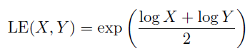
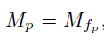
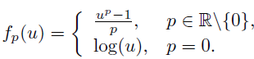
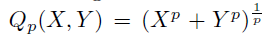
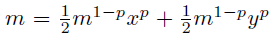
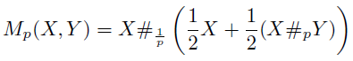
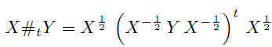
Which matrix geometric mean do you mean?
Scalar geometric mean:
can be obtained in several ways by considering limit of power means when p→0:
- quasi-arithmetic mean:
- solution of this equation:
Different matrix geometric means:
- matrix quasi-arithmetic mean:
- solution of this matrix equation:
Generalizations
Riemannian barycenter:
Riemannian distance on SPD cone
Ando, Li, and Mathias. "Geometric means."
Linear algebra and its applications 385 (2004): 305-334.

Slide 3
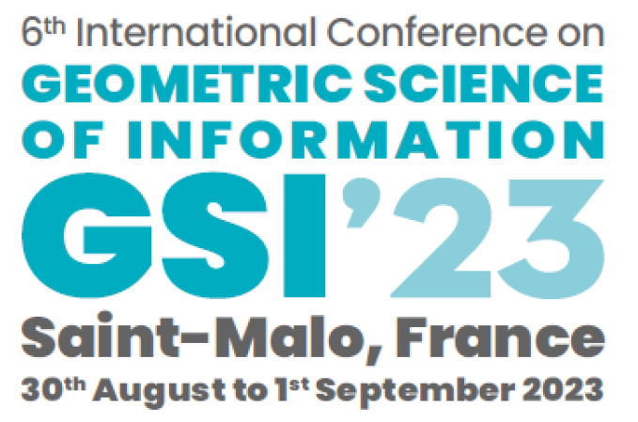
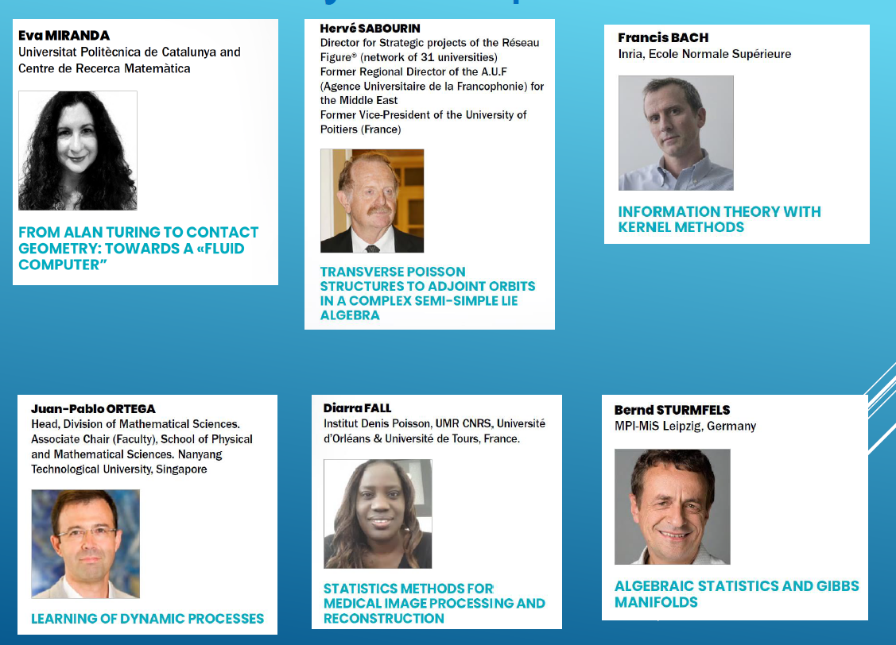
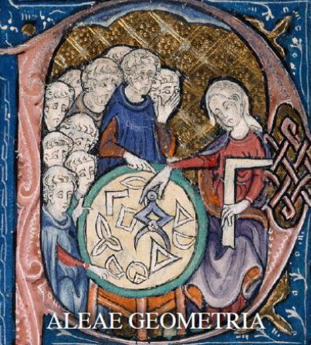
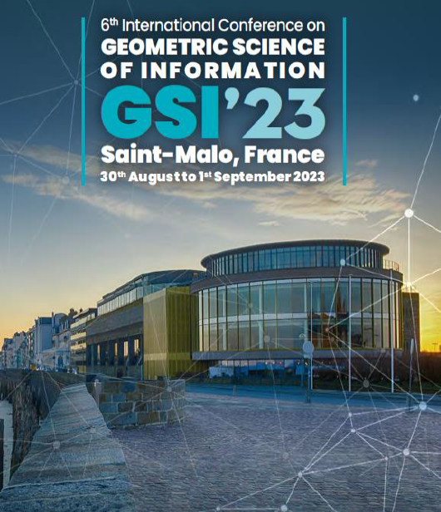

Slide 4
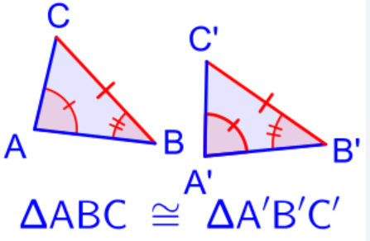
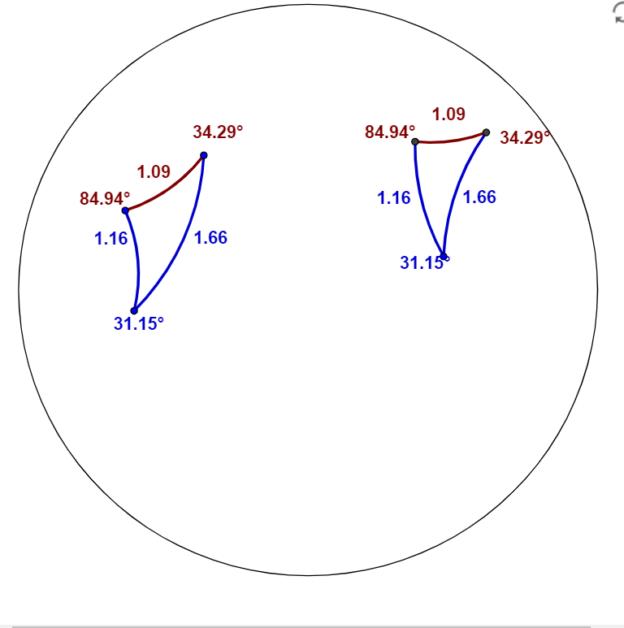
Side-Angle-Side theorem (SAS) in Euclidean and hyperbolic geometry
Avoid checking lengths and interior angles of two triangles to check whether they are congruent or not:
SAS theorem: Only need to check just two sides with their interior angles
Notes:
https://books.physics.oregonstate.edu/MNEG/psas.html

Slide 5
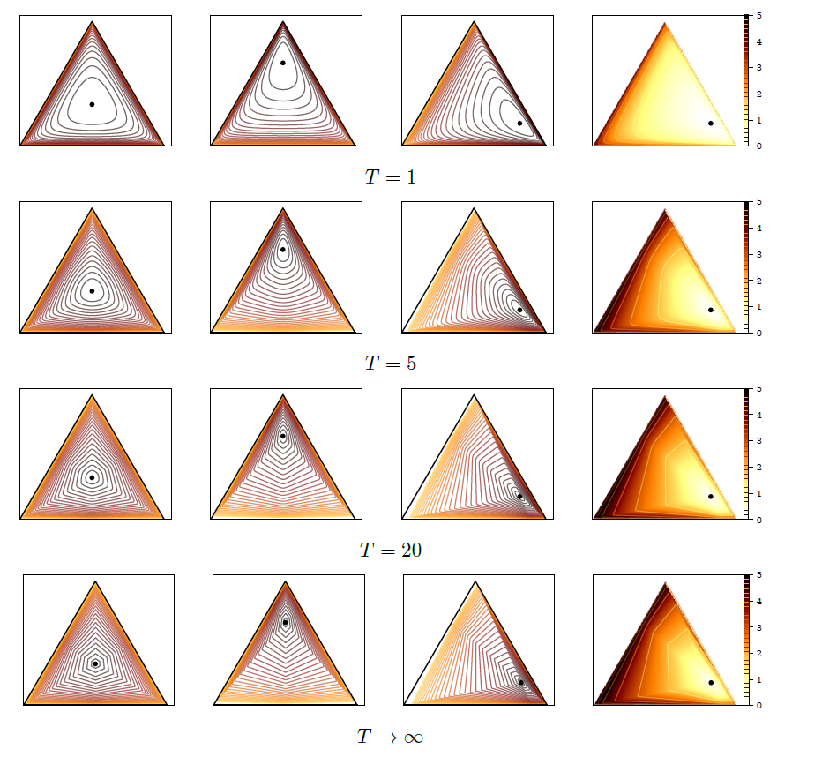
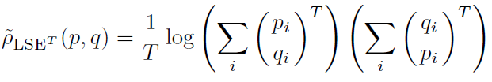
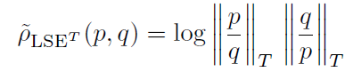
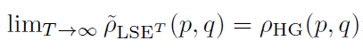
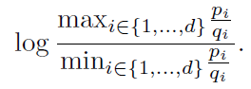
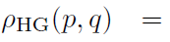
Differentiable approximations of Hilbert simplex distance
Differentiable approximations
h
Differentiable approximations of ρ_{HG} :
converges to Hilbert simplex distance:
Non-differentiable Hilbert simplex distance:

Slide 6
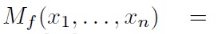
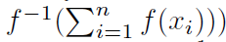
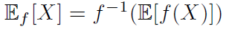
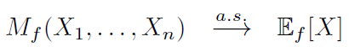
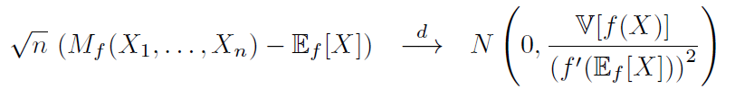
A generalization of the law of large numbers (LLN) and the central limit theorem (CLT)
Quasi-arithmetic means for a strictly monotone and smooth function f(u):
Quasi-arithmetic expected value of a random variable X:
Law of large numbers for an iid random vector with variance V[X]<∞:
Central limit theorem:
Miguel De Carvalho. Mean, what do you mean? The American Statistician, 70(3):270-274, 2016.

Slide 7
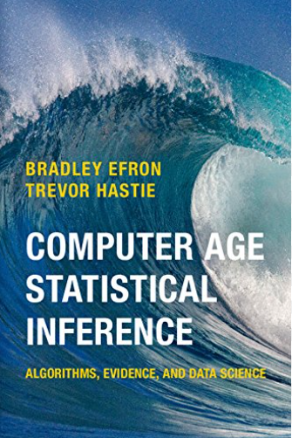
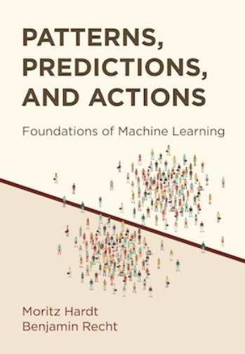

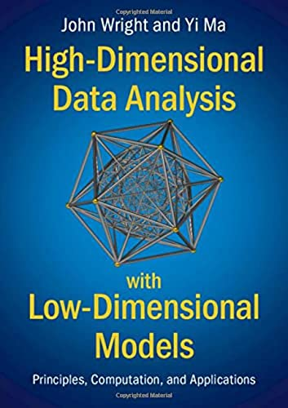

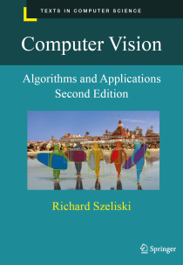
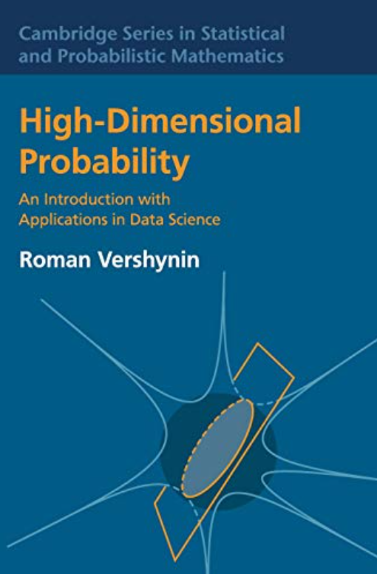
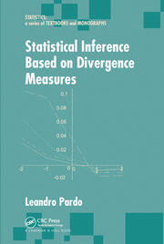
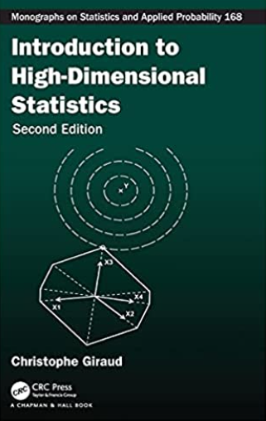

Slide 8
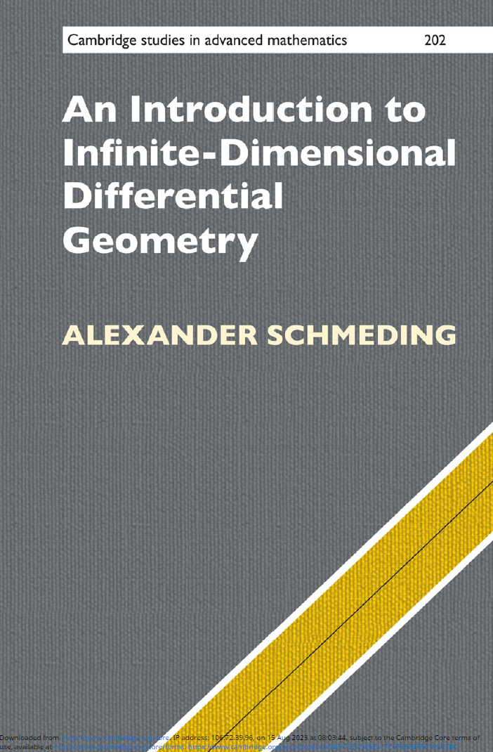
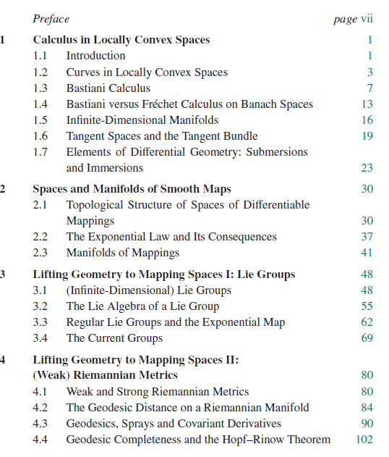
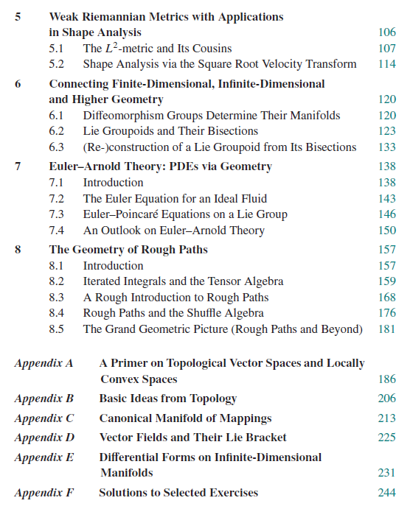

Slide 9
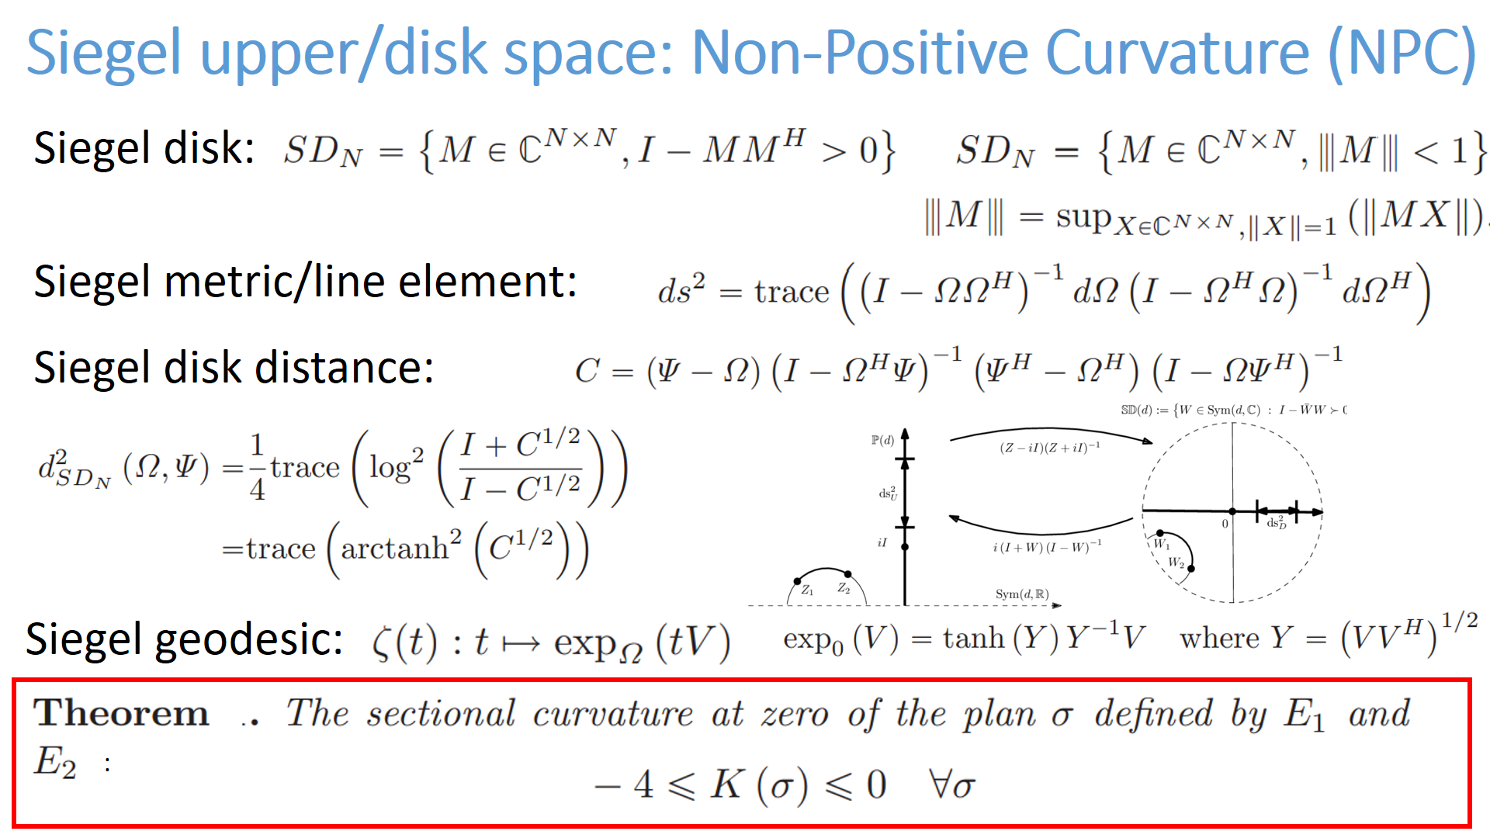

Slide 10
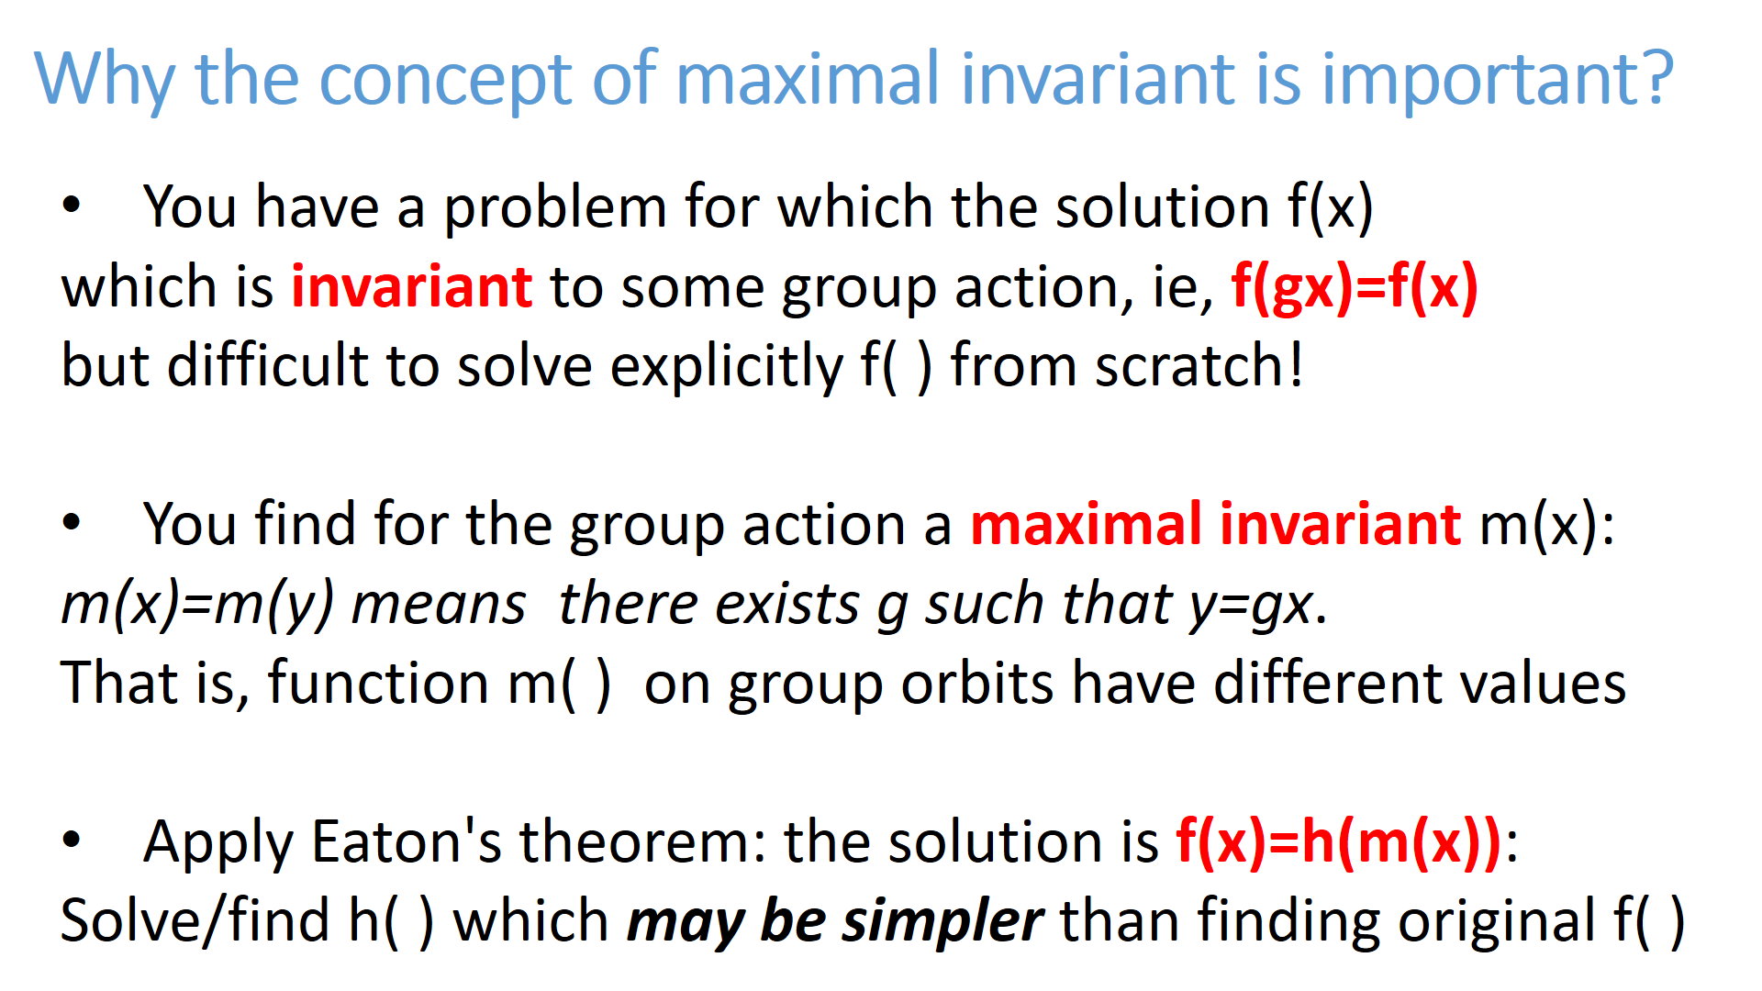
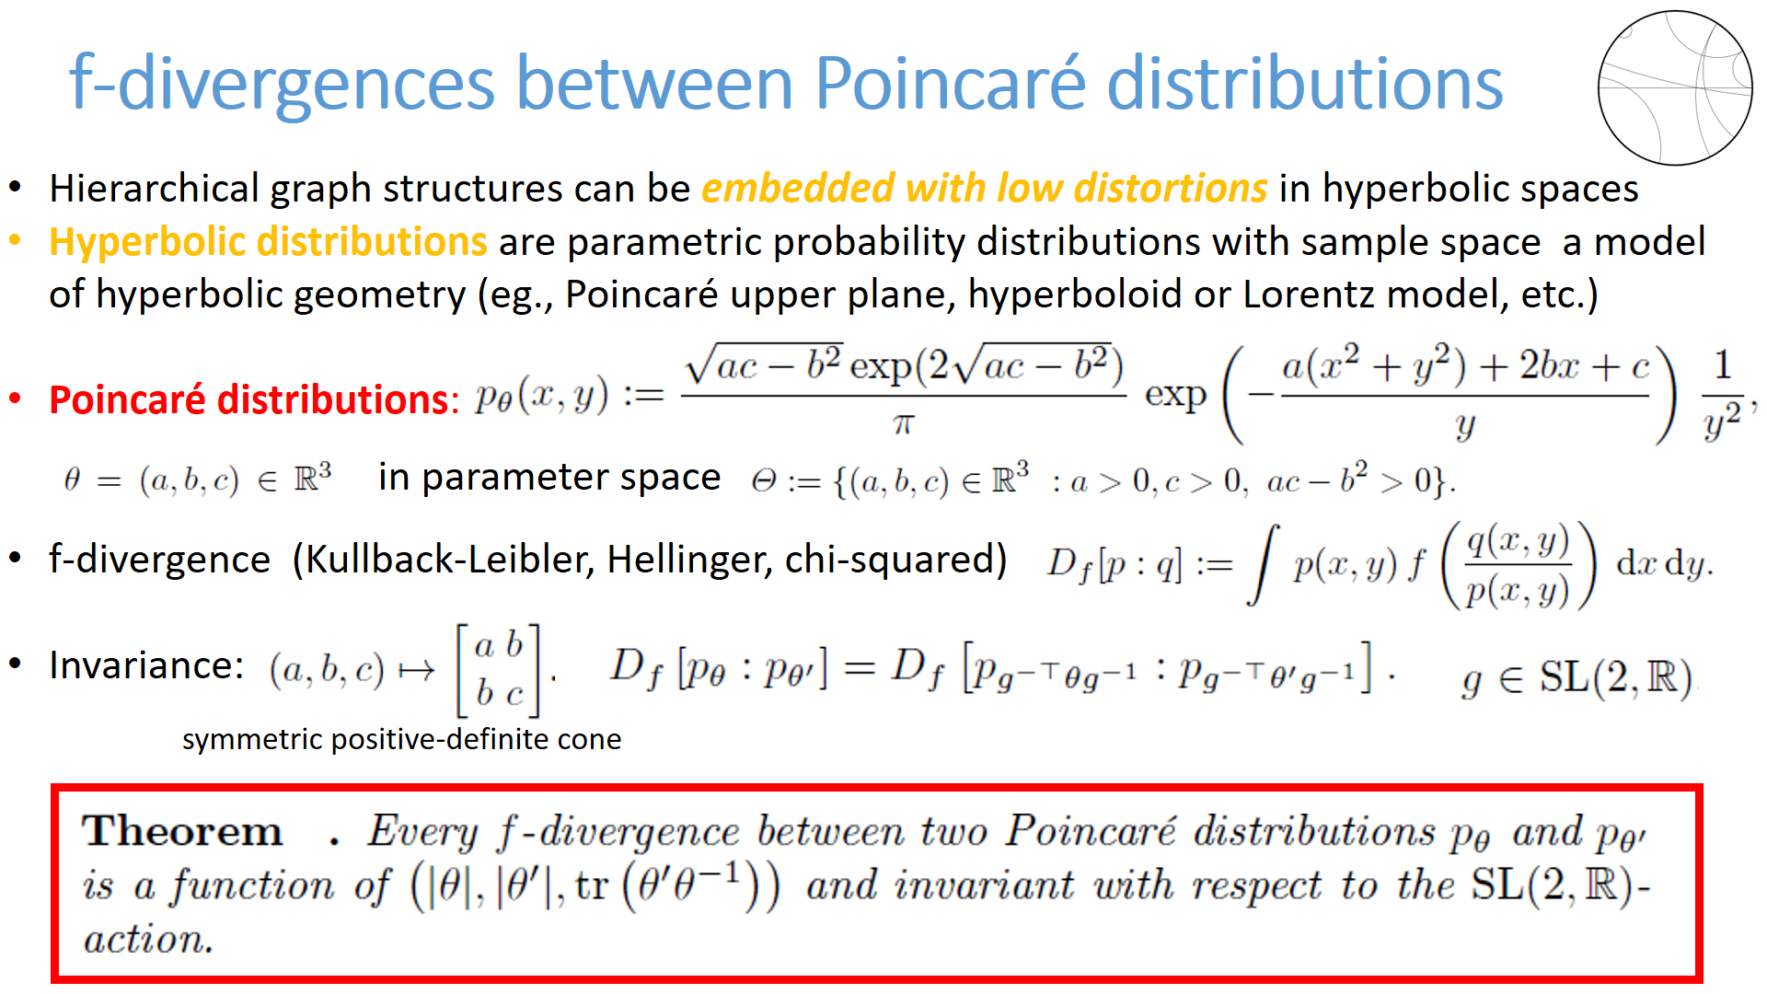

Slide 12
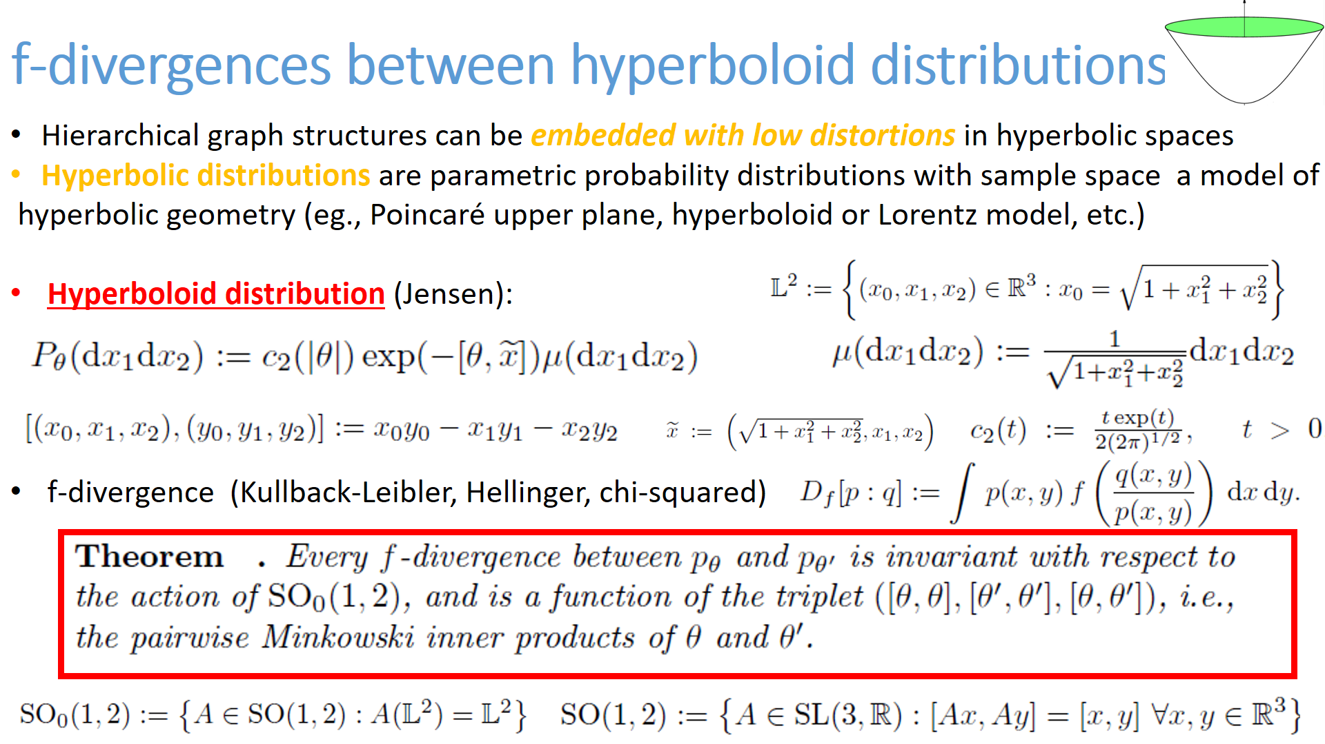

Slide 13
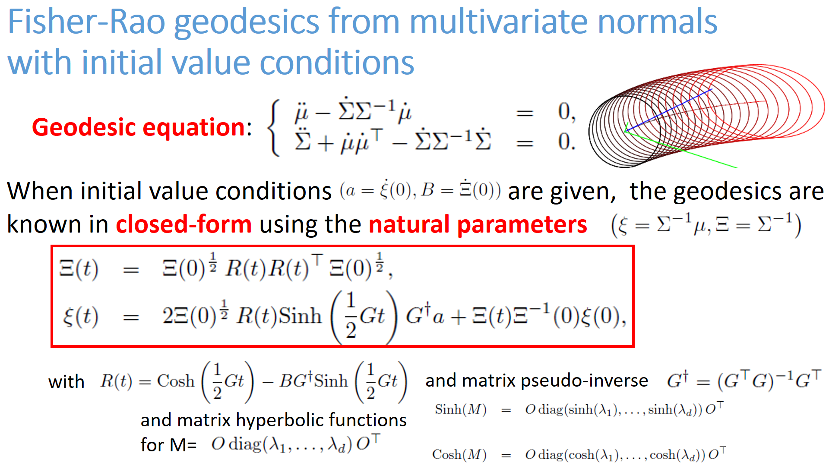

Slide 14
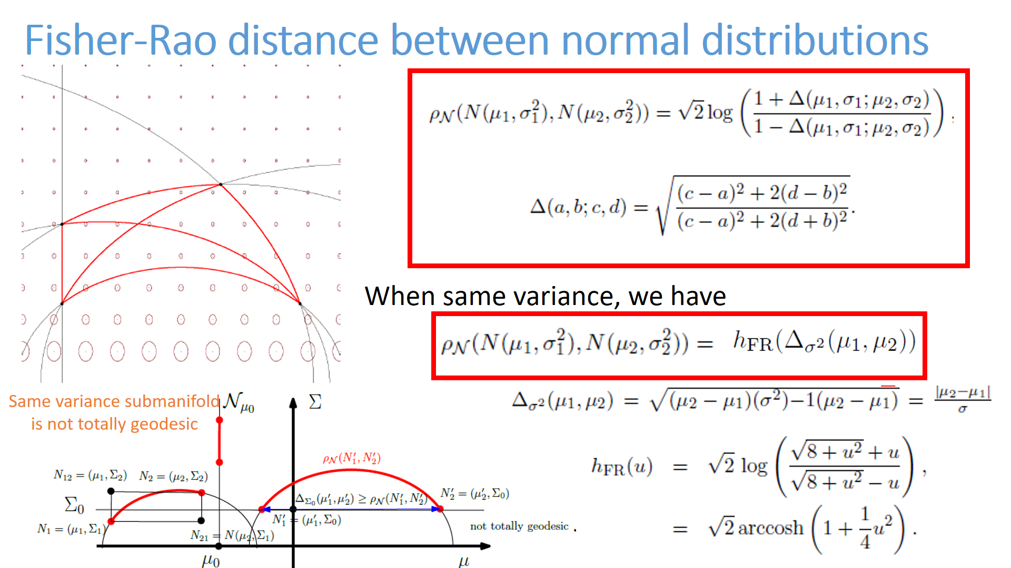

Slide 15
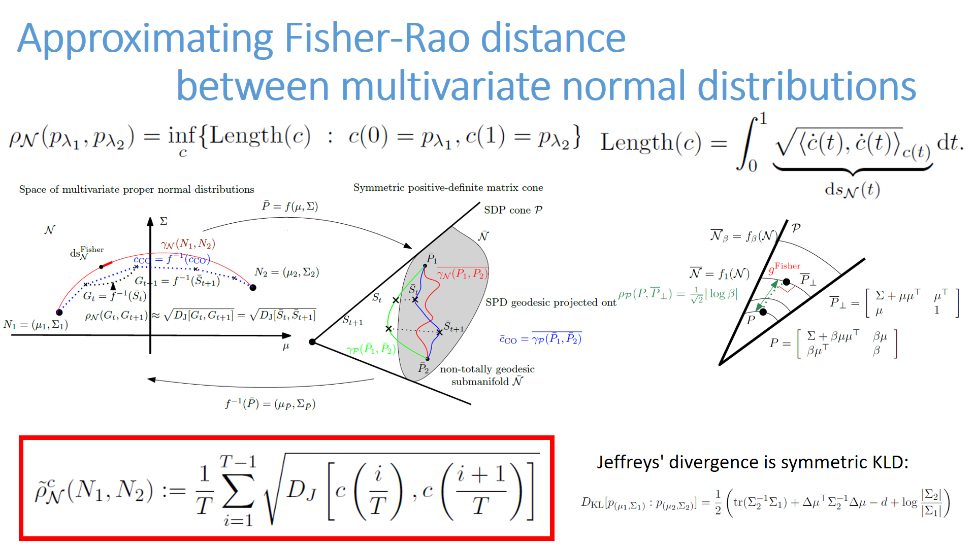

Slide 16
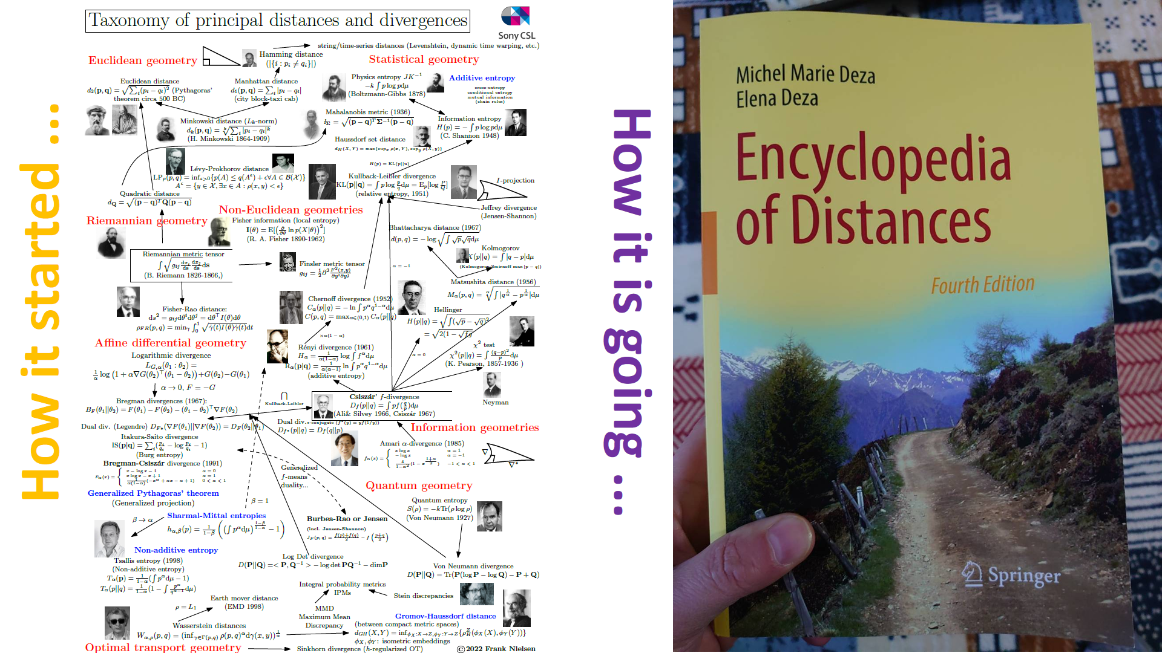

Slide 17
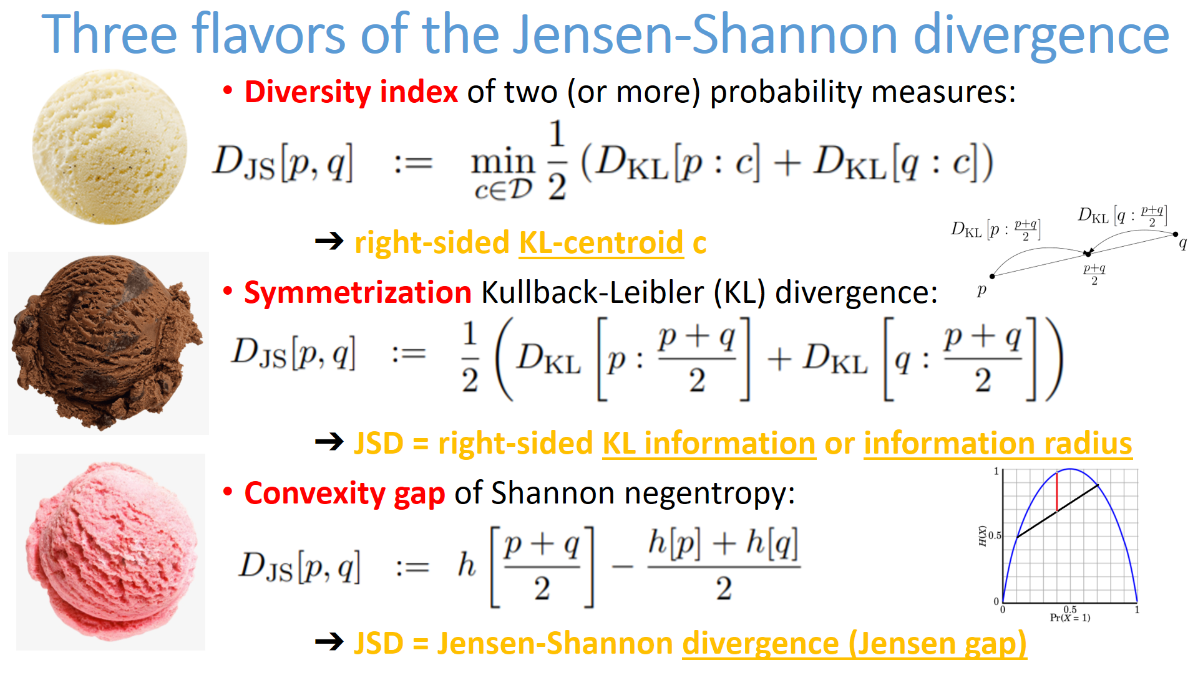

Slide 18


Slide 19


Slide 20





Fundamental theorem of Riemannian geometry
There exists a unique metric torsion-free connection ∇ induced
by the metric tensor g, called the Levi-Civita connection
3-covariant tensor ∇g acting on vector fields X, Y, and Z:
metric compatibility of ∇:
metric tensor g is preserved by parallel transport of ∇
Torsion-free ∇:
(Lie bracket)
Koszul formula defining ∇:
Notes:
Fundamental theorem of Riemannian geometry: There exists a unique metric torsion-free connection ∇ induced
by the metric tensor g, called the Levi-Civita connection given by the Koszul formula
$3$-covariant tensor acting on vector fields
$$
(\nabla g)(X,Y,Z) = X g(Y,Z)-g(\nabla_X Y,Z)-g(\nabla_X Z,Y)
$$
$$
\nabla g=0 \Longrightarrow X g(Y,Z) = g(\nabla_X Y,Z)+g(\nabla_X Z,Y)
$$
$$
\nabla_X Y-\nabla_Y X =[X,Y]
$$

